Slide 1
Downloading Dbeaver
Please do this before workshop

Slide 2


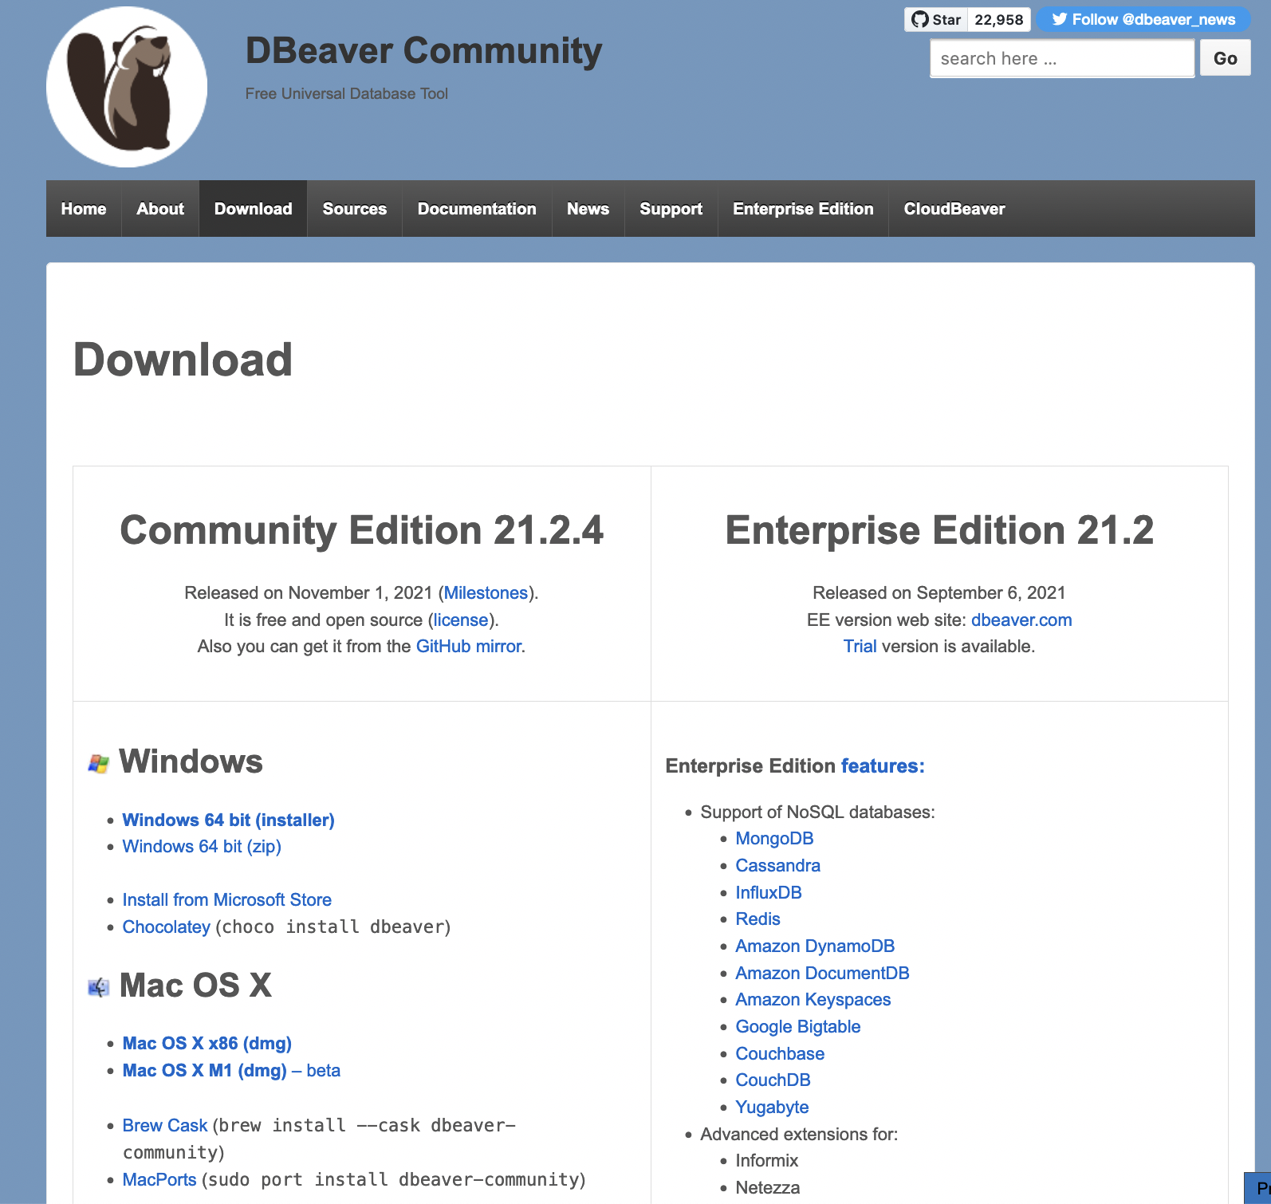
Steps to download
Website: https://dbeaver.io/download/
Navigate to downloads
Click on: Mac OS X x86 (dmg)

Slide 3
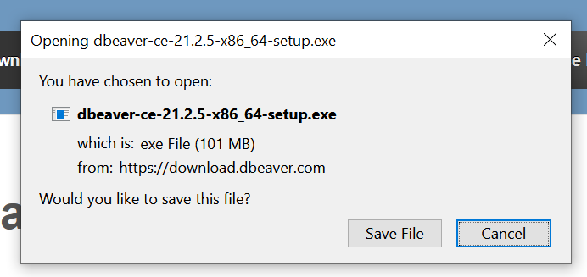
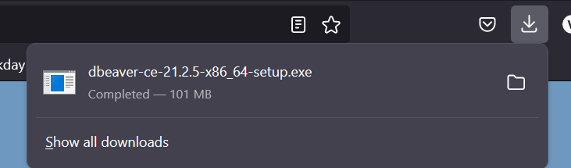
Steps to download (cont.)
Click Save File
Depending on which bowser you are using (chrome, firefox, etc.) you download will be on top or bottom of page
Click on download to open

Slide 4
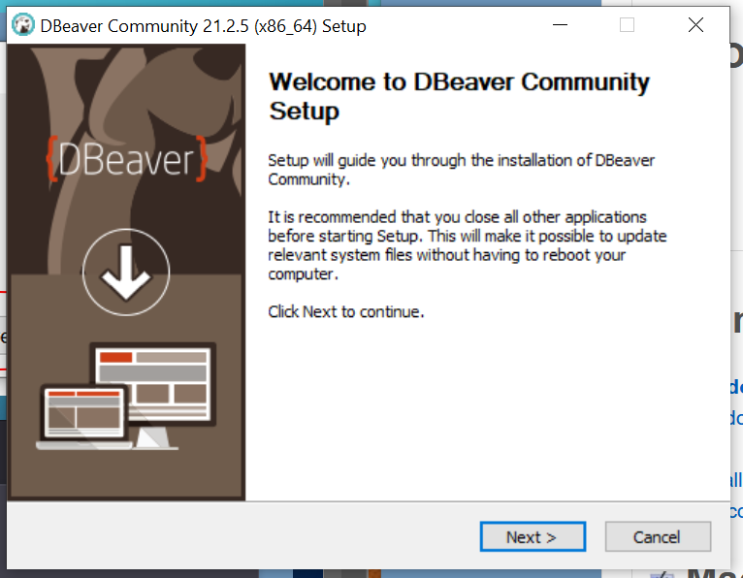
Steps to download (cont.)
Follow the wizard

Slide 5
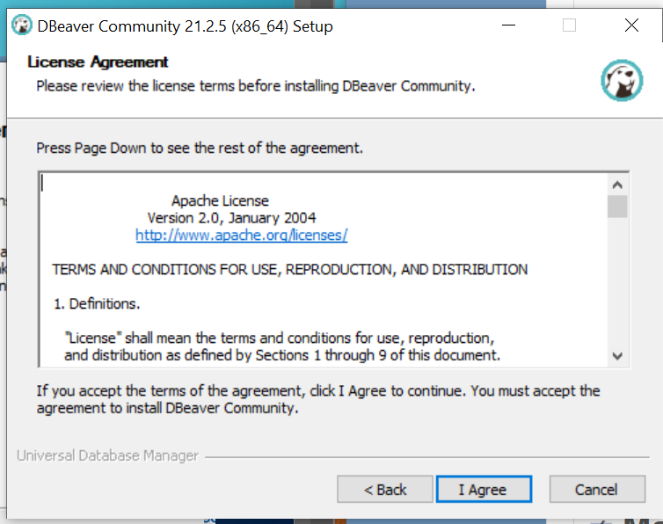
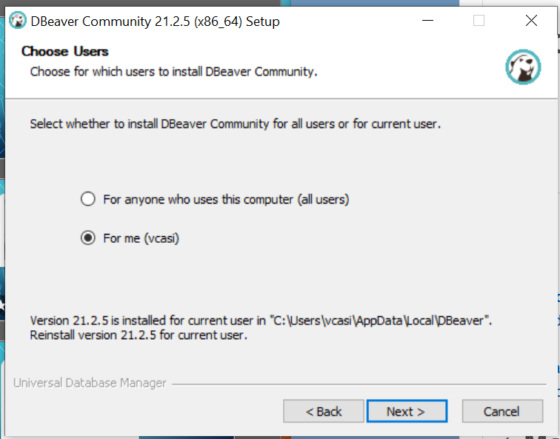
Steps to download (cont.)

Slide 6
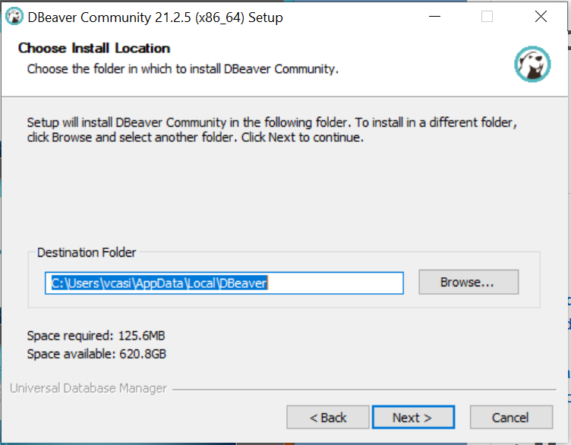
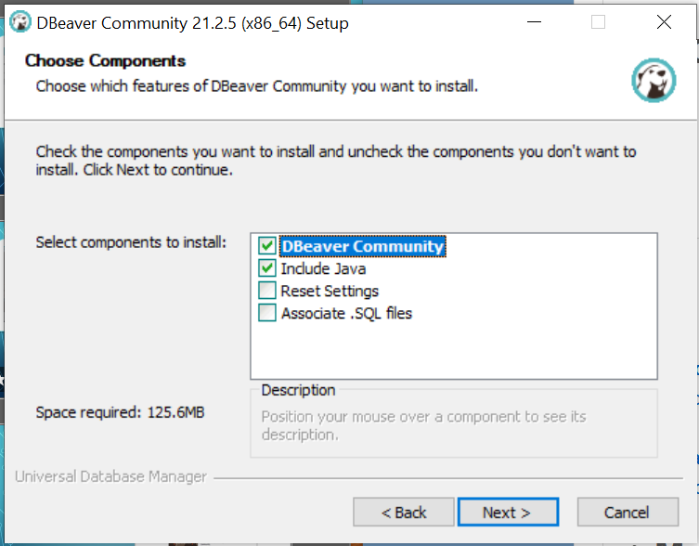
Steps to download (cont.)

Slide 7
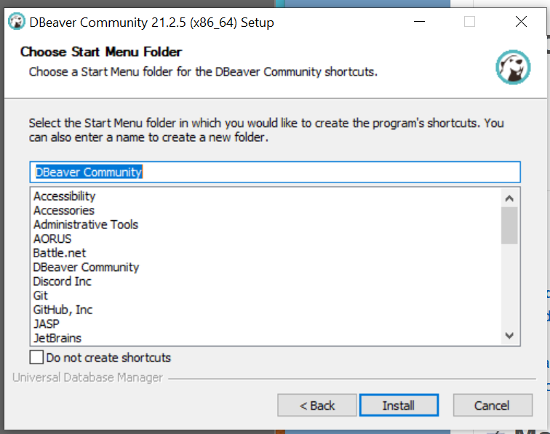
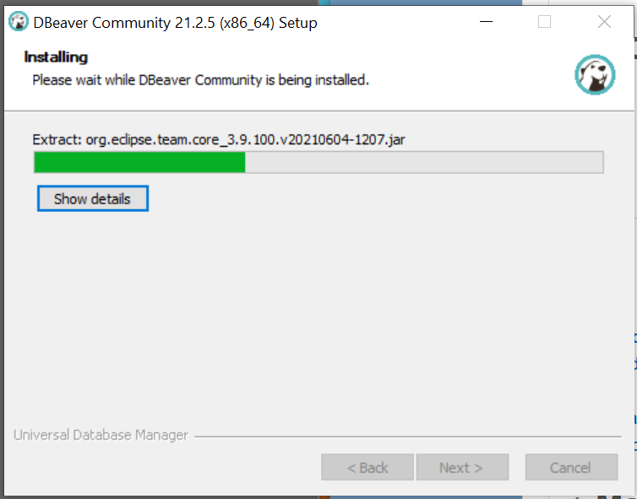
Steps to download (cont.)

Slide 8
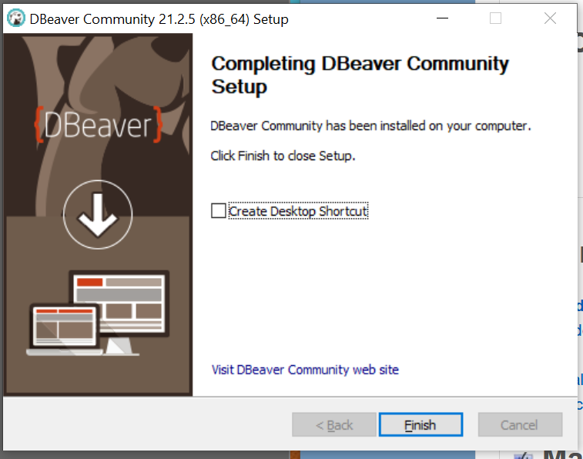
Steps to download (cont.)

Slide 9
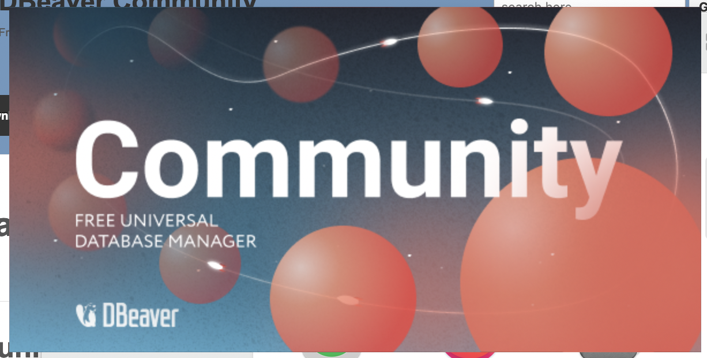
Steps to download (cont.)
This is what it should look like when you’re opening the application.

Slide 10
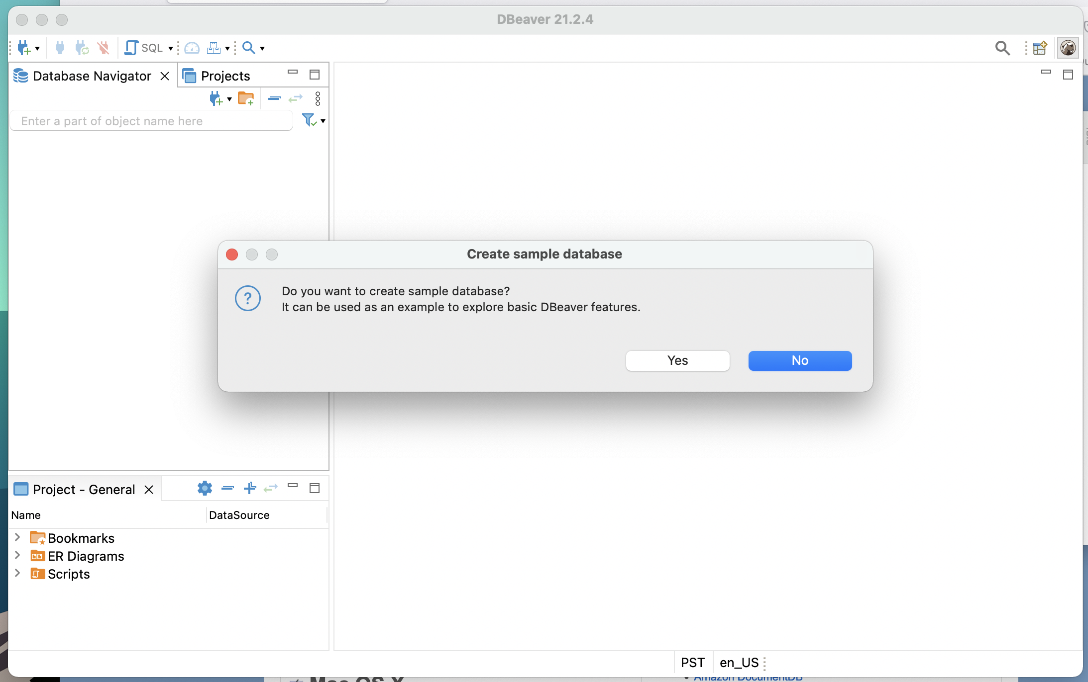
Steps to download (cont.)
First time opening it will ask if you would like to create a simple database, click yes. This is what we will be working with throughout the workshop. The SQL language will be SQL Lite.
NOTE: If you clicked no on accident, go to slide 16.

Slide 11
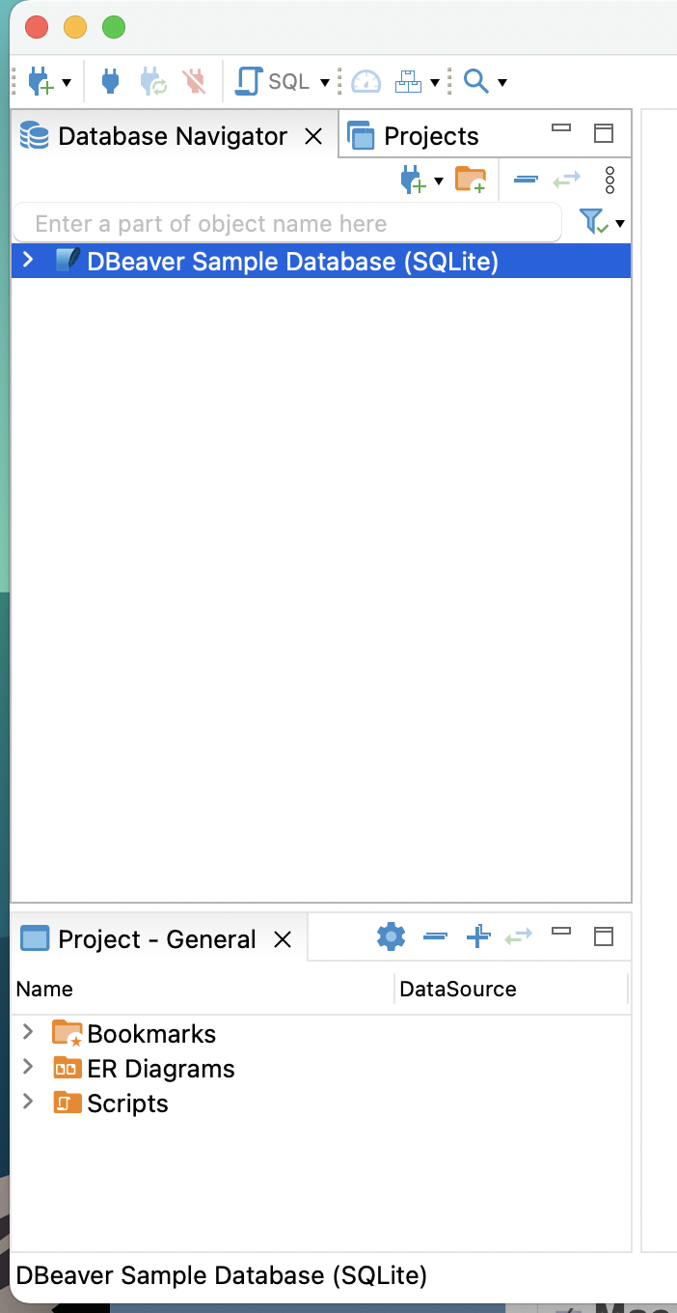
Steps to download (cont.)
This is what it should look like on your left-hand side of your program.

Slide 12
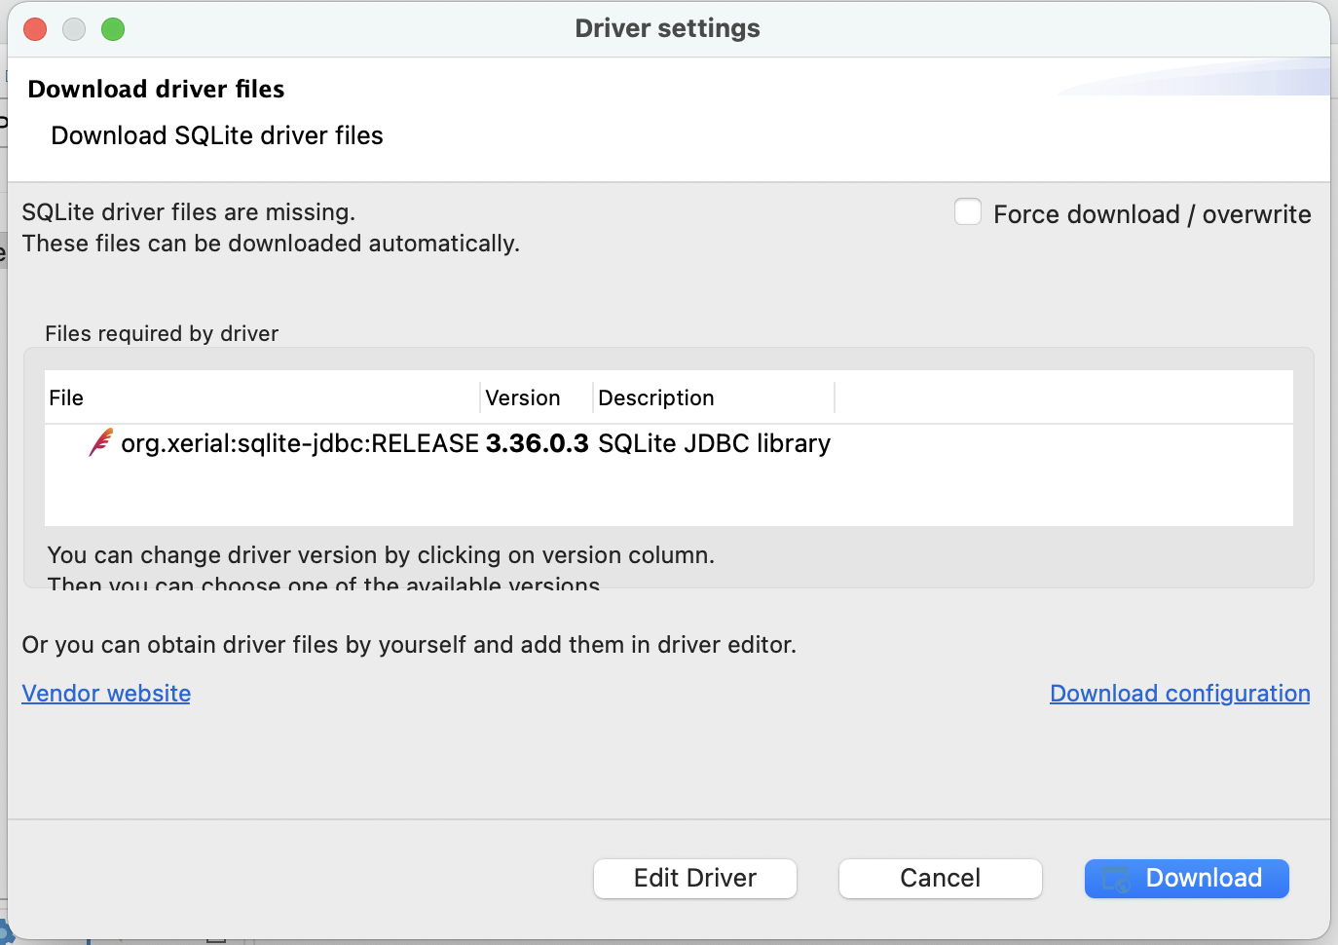
Steps to download (cont.)
When you first click on the database, this window will pop out click download.

Slide 13
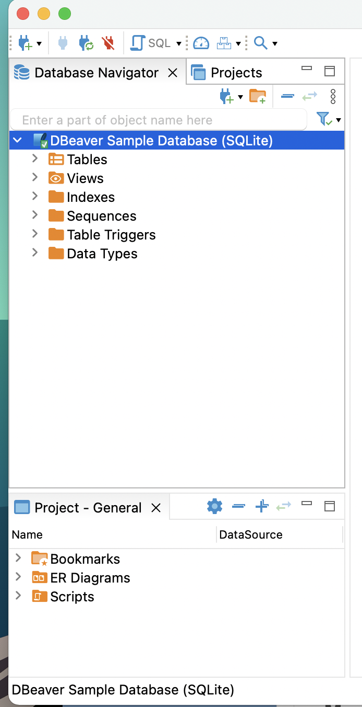
Steps to download (cont.)
Once it has finished downloading all of the drivers your left-hand side of the program should look like this.

Slide 14
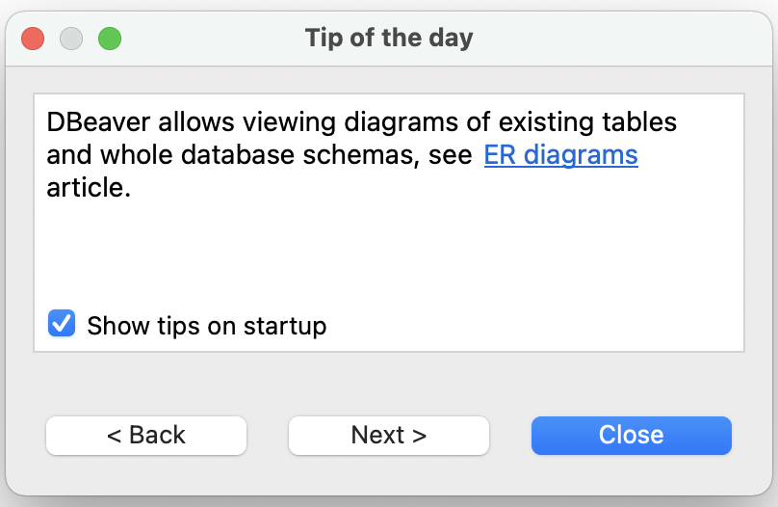
Steps to download (cont.)
When you open the program again usually this pops up, it’s just the tip of the day you can disable it by unclicking show tips on startup.

Slide 15
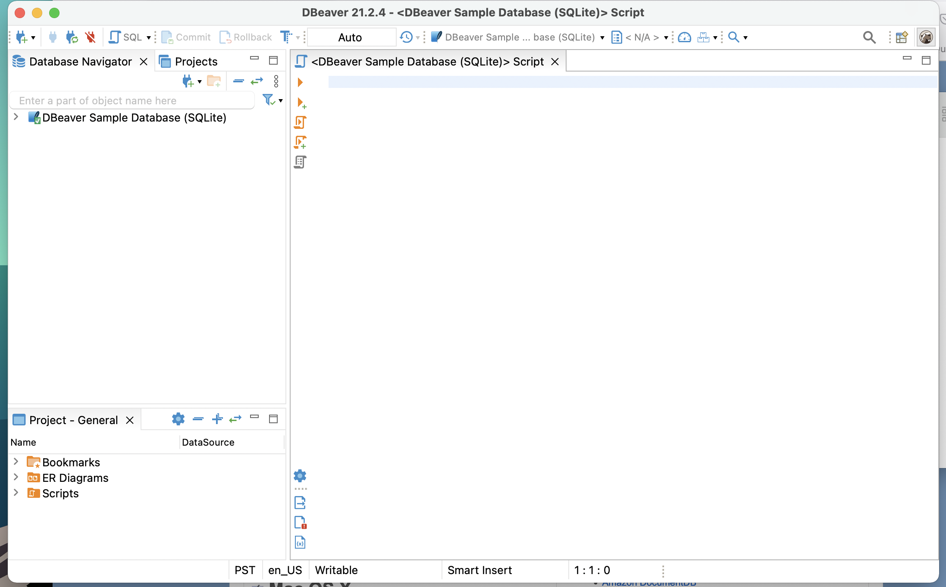
Steps to download (cont.)
Click at the top where it says SQL and it has a small little design of a fancy paper looking icon, it should open a script editor. This is what your full interface should look like before starting the workshop.

Slide 16
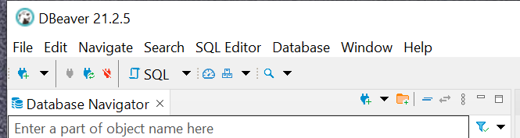
Let’s say you clicked no
Click here

Slide 17
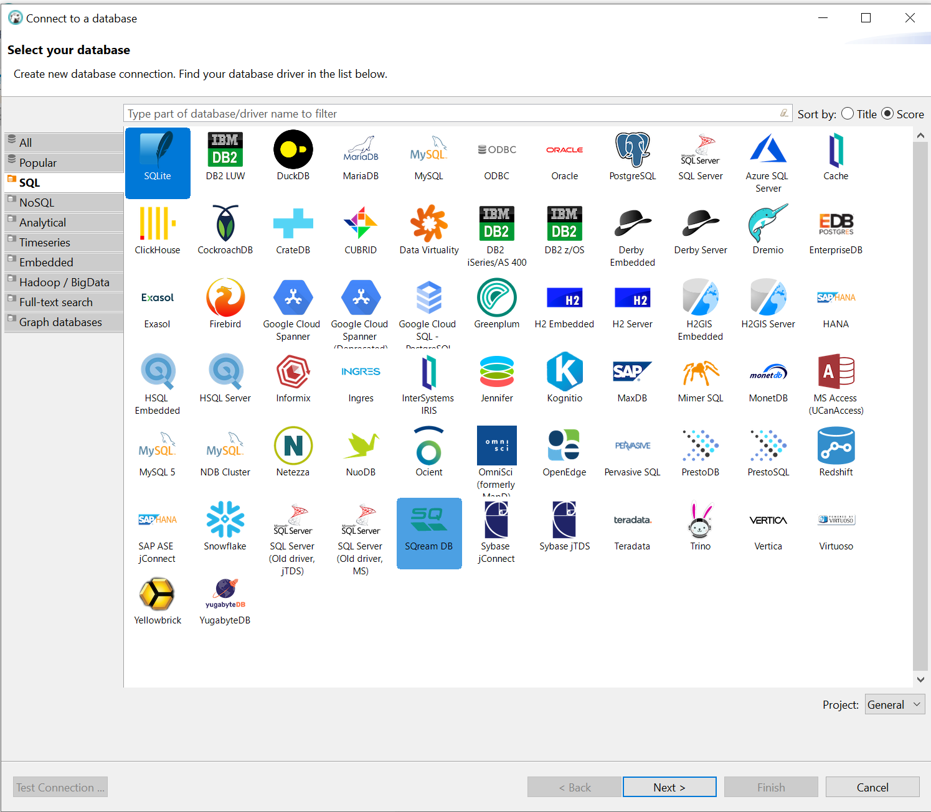
Pick DAtabases
Click on SQLite and click next

Slide 18
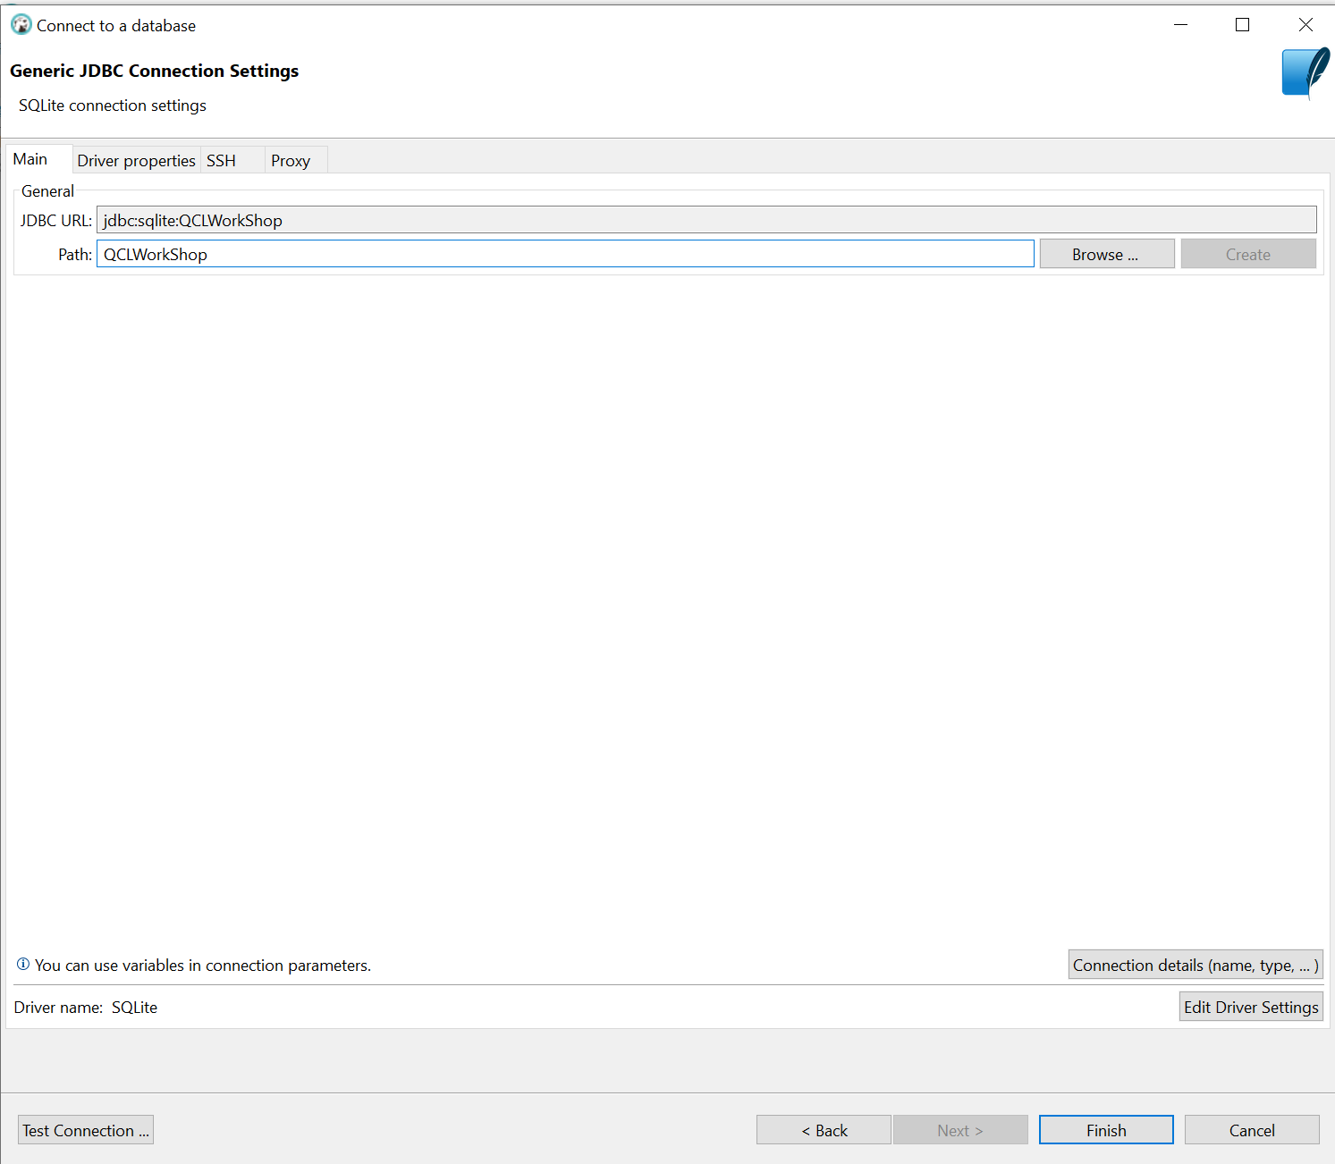
PAth
Type in Path: QCLWorkShop (you can name is whatever you like, this is just a suggestion for the workshop)
Click finish

Slide 19
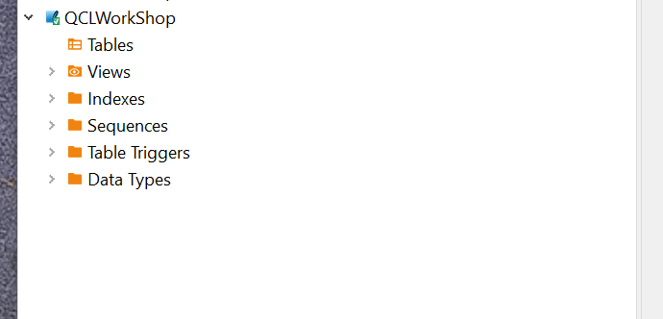
Ready for Work Shop
You should see your Database on the left-hand side of screen.

Slide 20
Workshop ready
Make sure to bring:
Computer
Dbeaver downloaded and setup

